Slide 1
DATA PRESENTATION
Marketing Analytics Portfolio Project

Slide 2
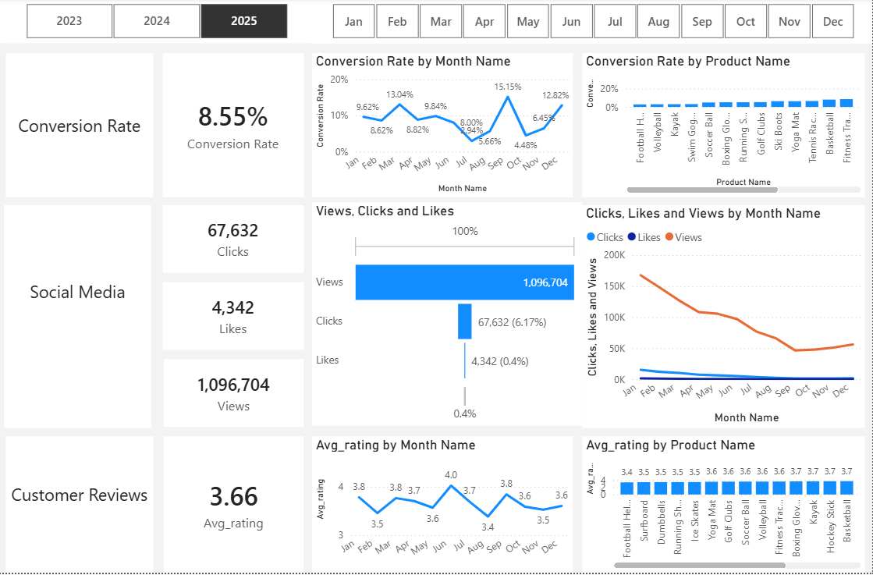
Overview
Decreased Conversion Rates: The Conversion Rate has been significantly reducing from 2023 which was 11.58% to 8.55% in 2025.
Reduced customer engagement:
There is a significant decline in overall social media engagement, with views decreasing throughout the year.
It’s also important to note that clicks and likes are significantly lower compared to views, with click-through-rate stands at 6.17% revealing low customer engagement.
Customer Feedback Analysis:
Customers rating have remained stable throughout the year, averaging around 3.66%.
Several products with an average rating below 3.5% suggest a need for improvement in customer satisfaction. Football helmets had the least rating of 3.39% which aligns with its conversion rate of 2.76%.

Slide 3
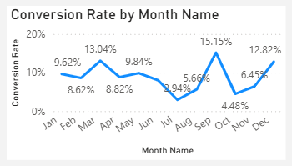
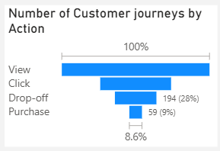
Decreased Conversion Rate
Conversion rate by month:
Conversion rate appears to be influenced by seasonality and marketing campaigns. In the last year, September, March and December significantly contributed to the average conversion rate, with conversion rates of 15.2%, 13% and 12.8% respectively. While July and October have lowest conversion rates of less than 5%.
Conversion rate by product name:
It is worth noting that most products that do well have their sales distributed across several months unlike those affected by seasonality. Hockey sticks and climbing ropes generated the most profits of above 20%.
Conversion Funnel Analysis:
The largest customer loss occurs between Click and Purchase stages suggesting many do not complete checkout.

Slide 4
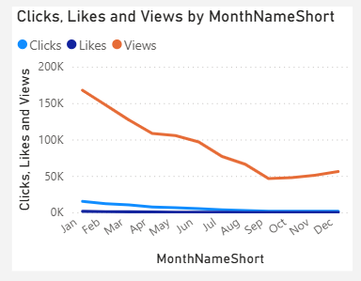
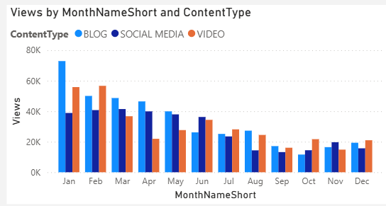
Reduced customer engagement
Lower Interaction Rates:
Millions of views annually suggests market campaigns have been successful in generating visibility, but user interaction still remains critically low, that is Clicks and Likes.
This suggests the need to create more engaging content and stronger call to actions.
Declining Views:
Views also declined steadily throughout the year especially later in the year indicating reduced customer engagement.
Content Type Performance:
Blog and social media content maintained steady engagement while video content performed inconsistently

Slide 5
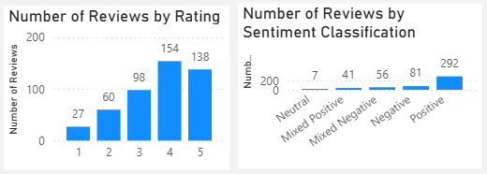
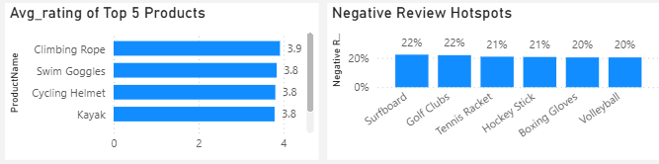
Customer feedback Analysis
Average rating:
The overall average rating has been consistent for the past three years averaging around 3.69%.
A positive rating of 61.22% was recorded in 2025 signifying that majority of the ratings were between 4 and 5.
Sentiment Classification:
Positive sentiments dominate at 292, reflecting a generally satisfied customer base.
Mixed Positive and mixed negative sentiments account for 41 and 56 reviews respectively presenting an opportunity to convert those sentiments to clearly positive ones
Product Reviews:
Overall, climbing ropes have the highest rating of 3.9% which aligns with its highest conversion rate.
On the other hand, Surfboards and Golf clubs have the highest negative reviews of 22% suggesting they should be prioritized for quality improvement.

Slide 6
Strategic recommendations
Increase Conversion
Improve low performing product marketing by implementing seasonal promotions or personalized campaigns during low performing months.
Simplify checkout and reduce friction during purchase because most visitors drop off between Click and Purchase stages.
Retarget visitors with abandoned carts.
Recreate successful campaigns for high converting products.
Enhance Engagement
Invest more in high-performing content formats like blogs and social media.
Optimize calls-to-action placement in social media and blog contents.
Increase interactive campaigns by experimenting with more engaging content such as participating in tiktok trends or interactive reels.
Improve Customer Satisfaction
Address mixed and negative feedback by analyzing common themes that emerge then develop improvement plans to address those concerns.
Follow up on dissatisfied customers to resolve their issues and encourage re-rating.
Address recurrent quality issues.
Continue monitoring customer sentiment.

Slide 7
Business Impact & Next Steps
If recommendations are implemented, the business can expect:
Higher conversion rates through reduced checkout abandonment.
Improved ROI by investing in the highest-performing marketing channels.
Increased customer loyalty through better product quality and customer experience.
Stronger data-driven decision-making by continuously monitoring KPIs and customer feedback.

